Slide 1
Quiz masters
Course: Introduction to Programming Project: Blackjack in C++

Slide 2
Content
Our team
01
It shows the members of our team
Our idea
02
It shows our idea
Planning stages
03
It shows how we planned things for the project
Technologies
04
The app we use

Slide 3
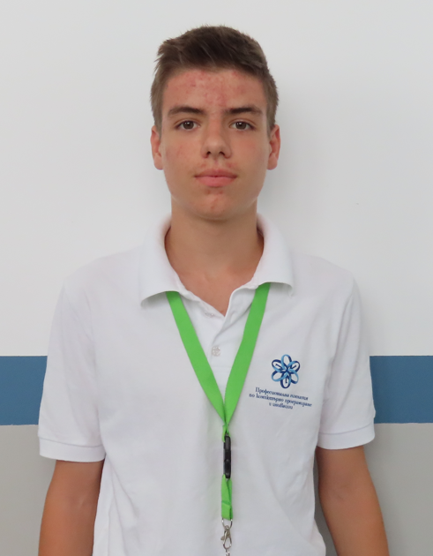
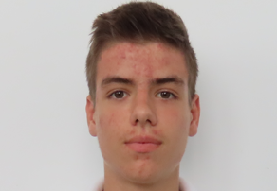
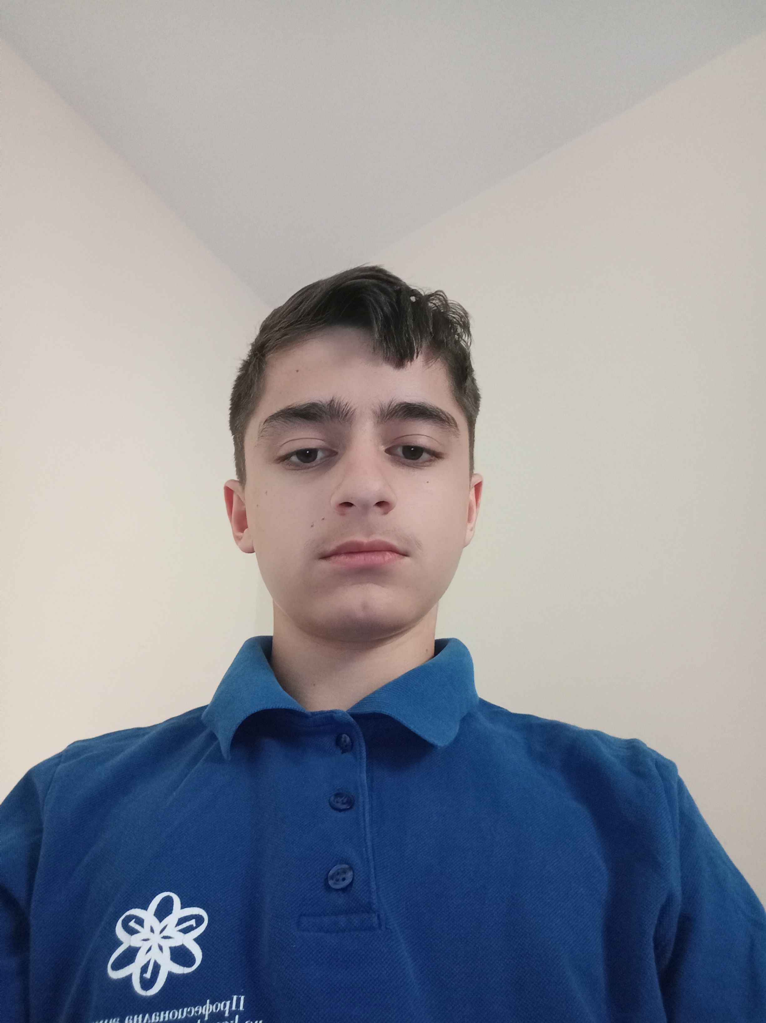
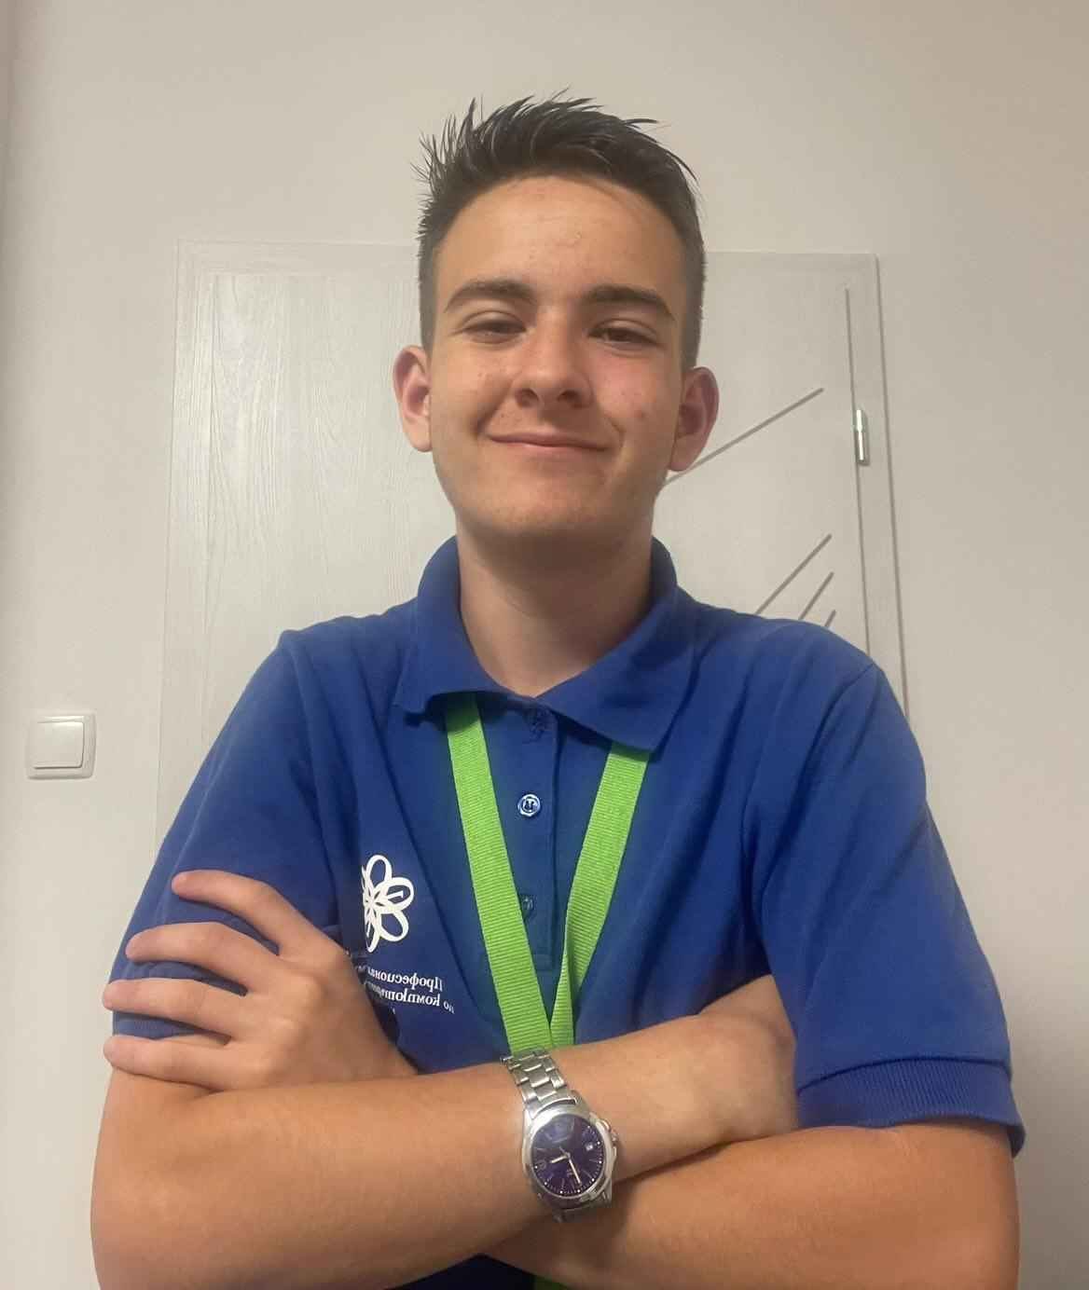
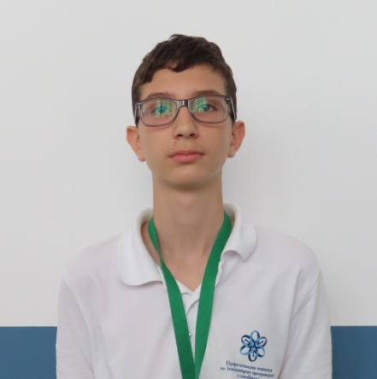
Memebers
MMTsonkov23
Stoyan Vassilev
VictorNikolov
SATomov23
-Scrum Trainer-
-Designer-
-Back End Developer-
-Front End Developer-

Slide 4

Our idea
Our idea is to create blackjack in which you will need to do math problems to see how much points is your card

Slide 5
Planning stages
Creating our team
Making our
idea
Making our
project
Presenting

Slide 6







Technologies

Slide 7
Now lets move to our game

